Slide 1
Incorporating Universal Design Principles and Evidence-Based Practices
To construct ADA Compliant Online Learning Environments in Higher Education

Slide 2
Universal Principles
UD
Universal Design
Mace (1985)
UDL
Scott, McGuire, and Foley (2003)
Adapts UD and UDL to higher education
Universal Design for Instruction
Universal Design for Learning
Meyer (1995)
Emphasis on use of computer technology to design accessible curriculum
UDI
Universal Design of Instruction
Burgstahler (2002)
Adapts UD and UDL to higher education while eliminating jargon
UDforI
UID
Universal Instructional Design
Silver, Bourke, and Strehorn (1998)
Attempt to create curriculum that eliminates need for accommodations
Architectural application
UDT
Universally Designed Teaching
Bowe (2000)
Uses UD and UDL to teach diverse learners

Slide 3
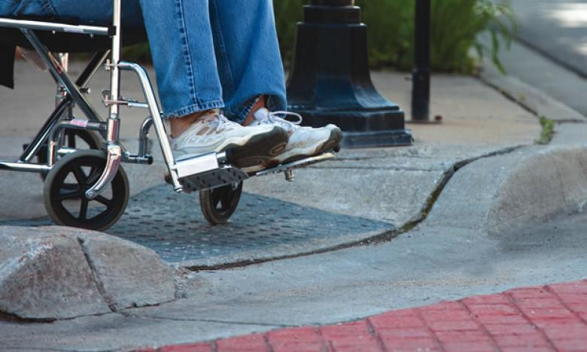
Accessibility
Source: Encore

Slide 4
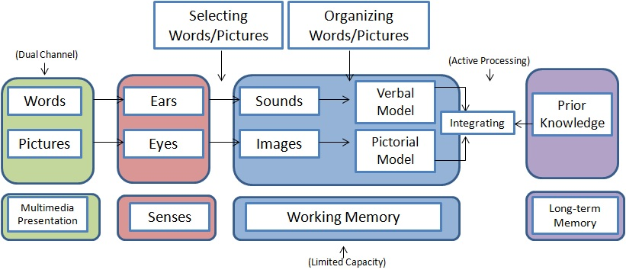
Curriculum Delivery
Source: Wikiversity

Slide 5
Student Demonstration
Source: Wright, “Take Your Pick!”

Slide 6
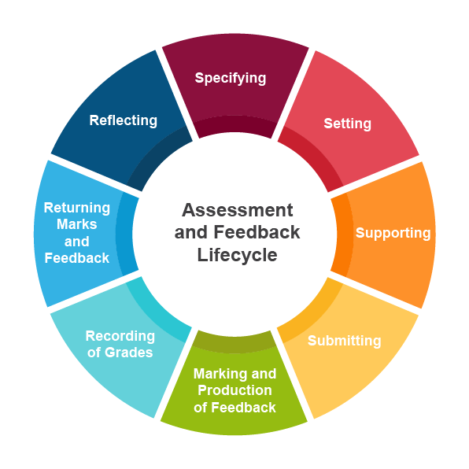
Assessment Methods
Source: University of Leicester Learning Institute

